Slide 1
From the Viscera to First Impressions: Phase-Dependent Cardio-Visual Signals Bias the Perceived Trustworthiness of Faces
Azevedo, R. T., von Mohr, M., & Tsakiris, M. (2023). From the Viscera to First Impressions: Phase-Dependent Cardio- Visual Signals Bias the Perceived Trustworthiness of Faces. Psychological Science, 34(1), 120–131.
Group 12：姚梦晗 郗悦 沈桐

Slide 2
1
Introduction
2
Studies
CONTENTS
3
Discussion
4
Conclusion

Slide 3
1
Introduction
Explain the reasons for choosing the essay and the research ideas within it.

Slide 4



1
Introduction
The formation of first impressions when researchers see new faces shapes our social interactions as researchers appraise others on the basis of their facial appearance. An important aspect of such appraisals relates to perceived trustworthiness (Winston et al., 2002).
Whereas past research has mainly focused on morphological or emotional cues of facial appearance, researchers here turned our attention to how visceral states that are interoceptively perceived can bias our first impressions.
Researchers implemented a cardio-visual stimulation paradigm to study the influence of transient interoceptive states on the perceived trustworthiness of new faces across three studies.
Notes:
（1）文章出发点及选择原因：当我们看到新面孔时，第一印象的形成会影响我们的社会交往，因为我们会根据他人的外貌来评价他们。这种评估的一个重要方面与感知的可信度有关。
（2）与以往的不同：过去的研究主要集中在面部外观的形态学或情感线索上，但我们在这里将注意力转向内感知的内脏状态如何影响我们的第一印象。
（3）因此研究者在以往研究中实施了一个心脏视觉刺激范式，通过三项研究来研究短暂的内感受状态对新面孔感知可信度的影响。

Slide 5
2
Study
Presentation of the details and conclusions of three experiments.

Slide 6
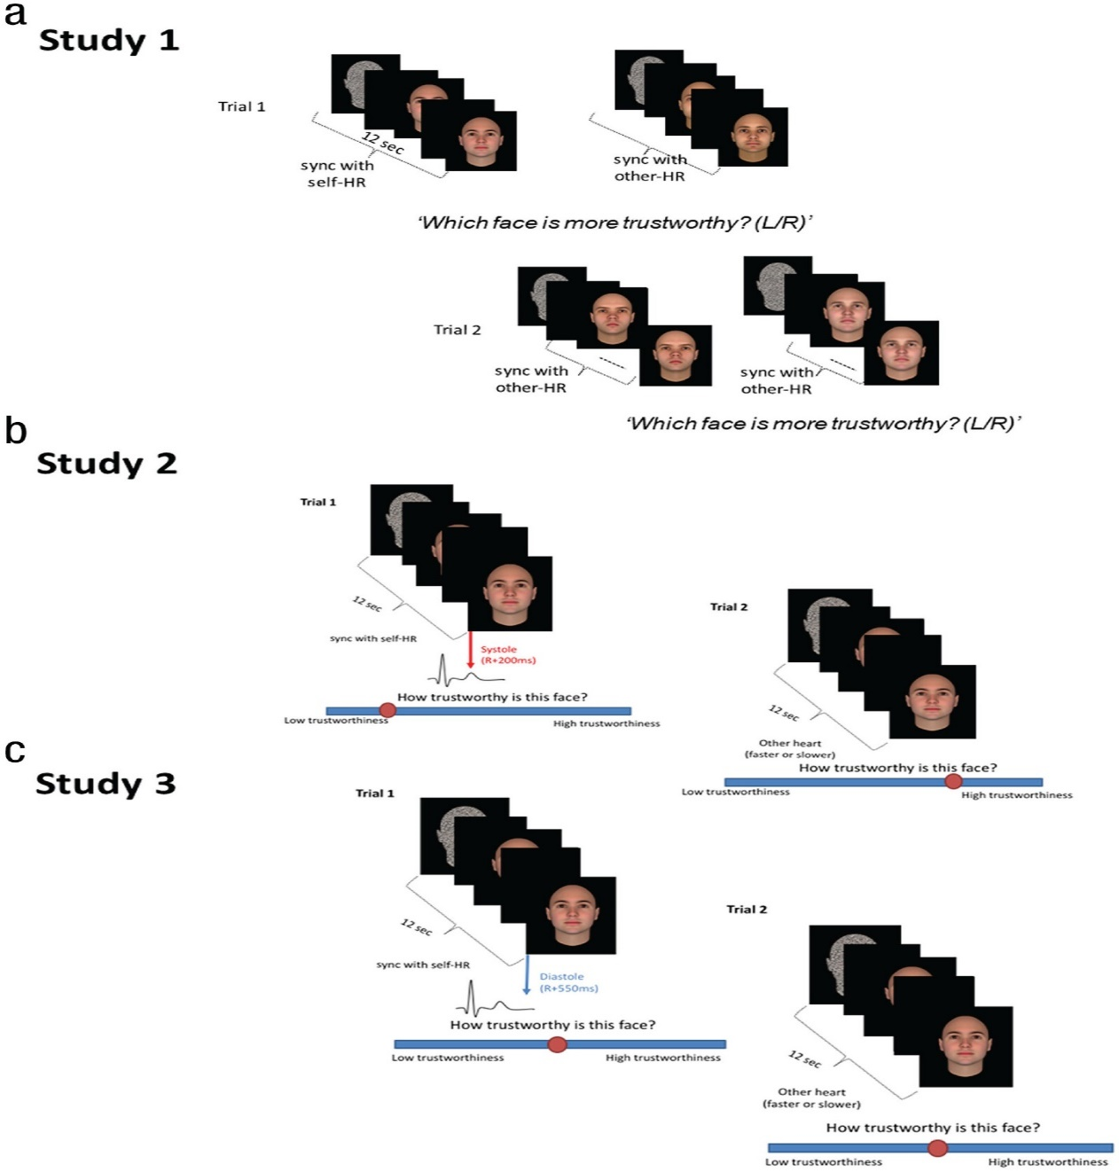
2
Study Overview
Participants judged the perceived trustworthiness of faces flashing either in frequency and phase synchrony (i.e., at systole) with their own heartbeats (systole-self condition) or following someone else’s previously recorded heart rhythms (other-hearts conditions).
1&2
3
Study 3 followed the same paradigm but with a constant phase shift in the cardio-visual synchrony to coincide with cardiac diastole (diastole-self condition), rather than systole, to test whether the cardiac influence is dependent on the phase of the cardiac cycle.
Notes:
（1）在研究1和2中，参与者判断人脸闪烁的频率和相位同步性(即，在心脏收缩期)与他们自己的心跳(心脏收缩期-自身条件)或跟随他人先前记录的心律(其他心脏条件)的感知可信度。
（2）研究3遵循相同的范例，但是在心脏-视觉同步中具有恒定的相移，以与心脏舒张期(舒张期-自身条件)一致，而不是与心脏收缩期一致，以测试心脏影响是否依赖于心动周期的相位。

Slide 7
2.1
Study 1
Images (400 × 477 pixels) of computer-generated Caucasian male faces with neutral facial expressions against a black background
Three disposable ECG electrodes were placed in a modified lead I chest configuration.
01
03
05
Stimuli
Synchronization procedure
Participants
02
04
Results
35 volunteers (age: M = 22.6 years, SD = 3.4; 27females)
which face is more trustworthy?
Trustworthiness judgment task
Study1 video
Notes:
研究一选取了35名志愿者。在具体过程中，每项试验开始时都给参与者呈现两种形状的脸(面具)并排闪烁，然后被两张不同的男性脸的图片取代，这些图片以相同的节奏持续闪烁，要么与参与者自己在心脏收缩期的心律(HR)同步(左)，要么与其他人之前记录的略快HR同步(右)。一旦这些面孔从屏幕上消失，参与者被要求按一个键来回答这个问题，“哪张面孔更值得信任？”

Slide 8
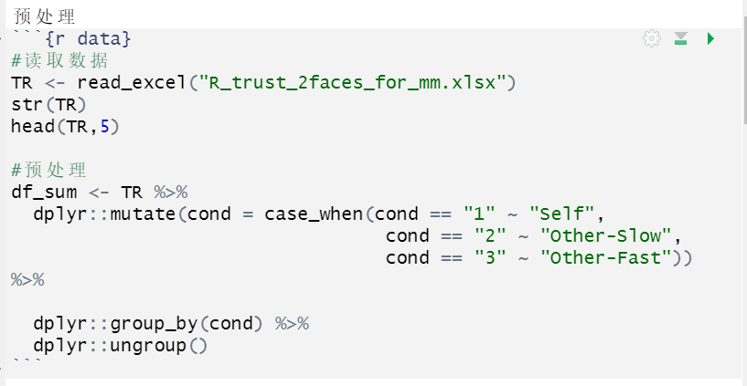
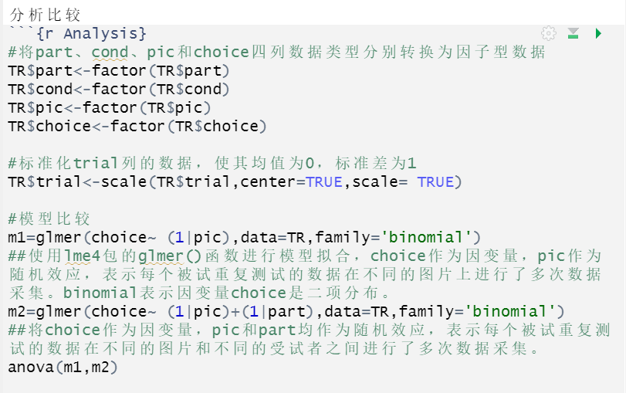
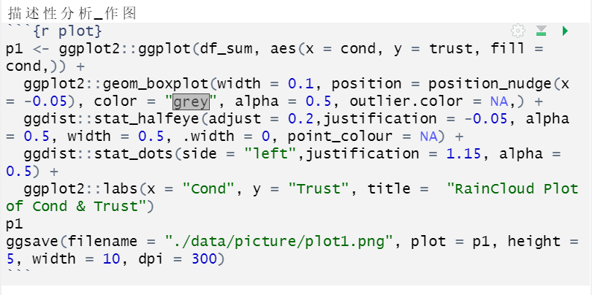
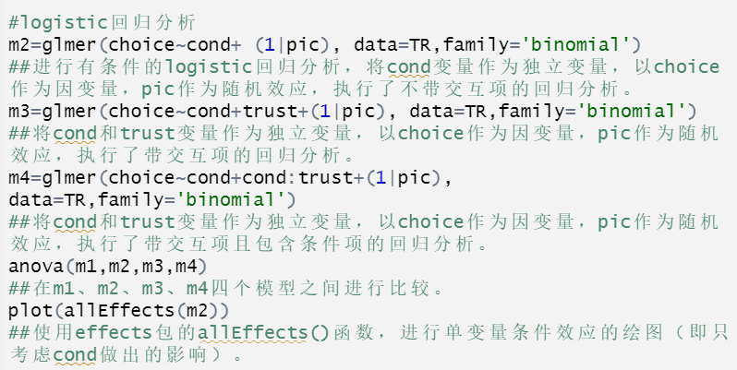
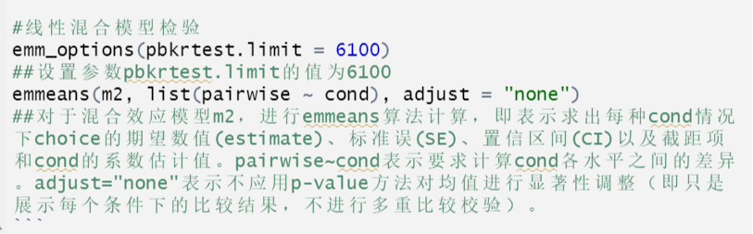
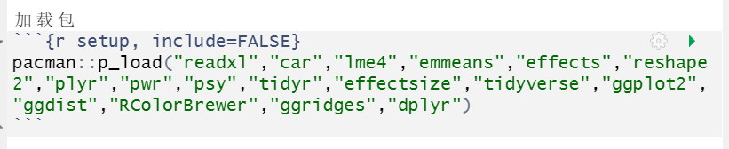
2.1
Study 1——Code Reproduction

Slide 9
2.1
Study 1——Result
(1)People less often chose faces synchronized with their own heart as more trustworthy (M = 28.26, SD = 3.66, 95% confidence interval [CI] = [27.00, 29.51]) than faces synchronized with other-slow (M = 30.66, SD = 3.72, 95% CI = [29.38, 31.93]), t(34) = −2.40, p = .022, Cohen’s d = 0.40, and other-fast (M = 31.08, SD = 4.39, 95% CI = [29.58, 32.60]), t(34) = −2.33, p = .026, Cohen’s d = 0.39.
(2) No difference between other-fast and other-slow trials was observed, t(34) = −0.35, p = .73, Cohen’s d = 0.059.
Using multilevel mixed log-linear regression analysis to control for the possible picture-specific effects and to understand whether the effect of rhythm varied according to the “objective” level of trustworthiness of each face pair.
Notes:
研究一结果：(1) 因变量为每个参与者选择随着每种节奏闪烁的面孔作为更可信面孔的次数，重复测量方差分析(ANOVA ),将节律(自身收缩、其他-缓慢、其他-快速)作为受试者内因素，并在每个节律之间进行事后比较。结果发现与其他人同步的面孔相比，人们更少选择与自己的内心同步的面孔，因为他人同步更值得信任。(2)没有观察到其他快速和其他慢速试验之间的差异,使用多水平混合对数线性回归分析对数据进行了重新分析，以控制可能的图片特异性效应(即项目水平的可变性)，并了解节奏的影响是否根据每个面孔对的“客观”可信度水平而变化。这一分析证实了节奏的主要影响，并揭示了节奏和面孔对的可信度之间没有相互作用。因此，与根据他人预先录制的心律闪烁的面孔相比，参与者更少选择与自己心律同步的面孔作为更可信的面孔，这表明当从他人的面孔进行社会推断时，正在进行的内部感受信息的影响。然而，由于两张面孔几乎同时呈现，也有可能与参与者心脏同步呈现的刺激给予的关注较少，因此选择的频率较低。为了排除这种假设，研究者们进行后续研究。

Slide 10
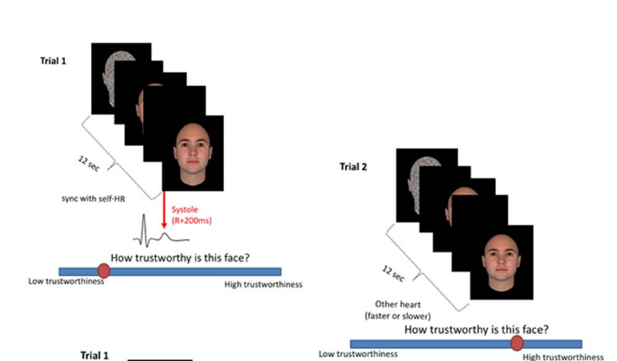
2.2
Study 2
01
Purpose: rule out the possibility that the previously observed effects were driven by attention competition between the two faces.
02
Participants:30 volunteers (age: M = 24.17 years, SD = 4.90; 21 females)
03
DOE: The stimuli, task, and procedures were identical to those of Study 1 with the exception that in this study, only one face was presented at a time in the center of the screen.

Slide 11
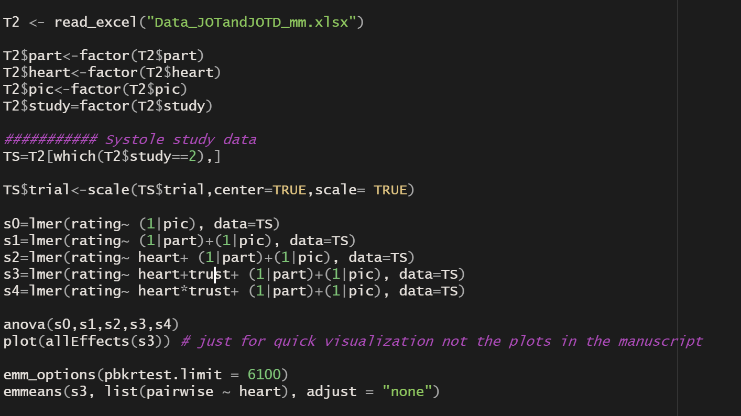
2.2
Study 2
Result: lower trustworthiness ratings for faces in the systole-self compared with those in the other-slow, and other-fast . no difference in the ratings given to faces in the other-slow and other-fast conditions.
linear mixed model regression analysis : only the main effect of rhythm, and not its interaction with trustworthiness, levels, was found to be significant.
04
05
DA: analysis of variance、linear mixed model regression analysis

Slide 12
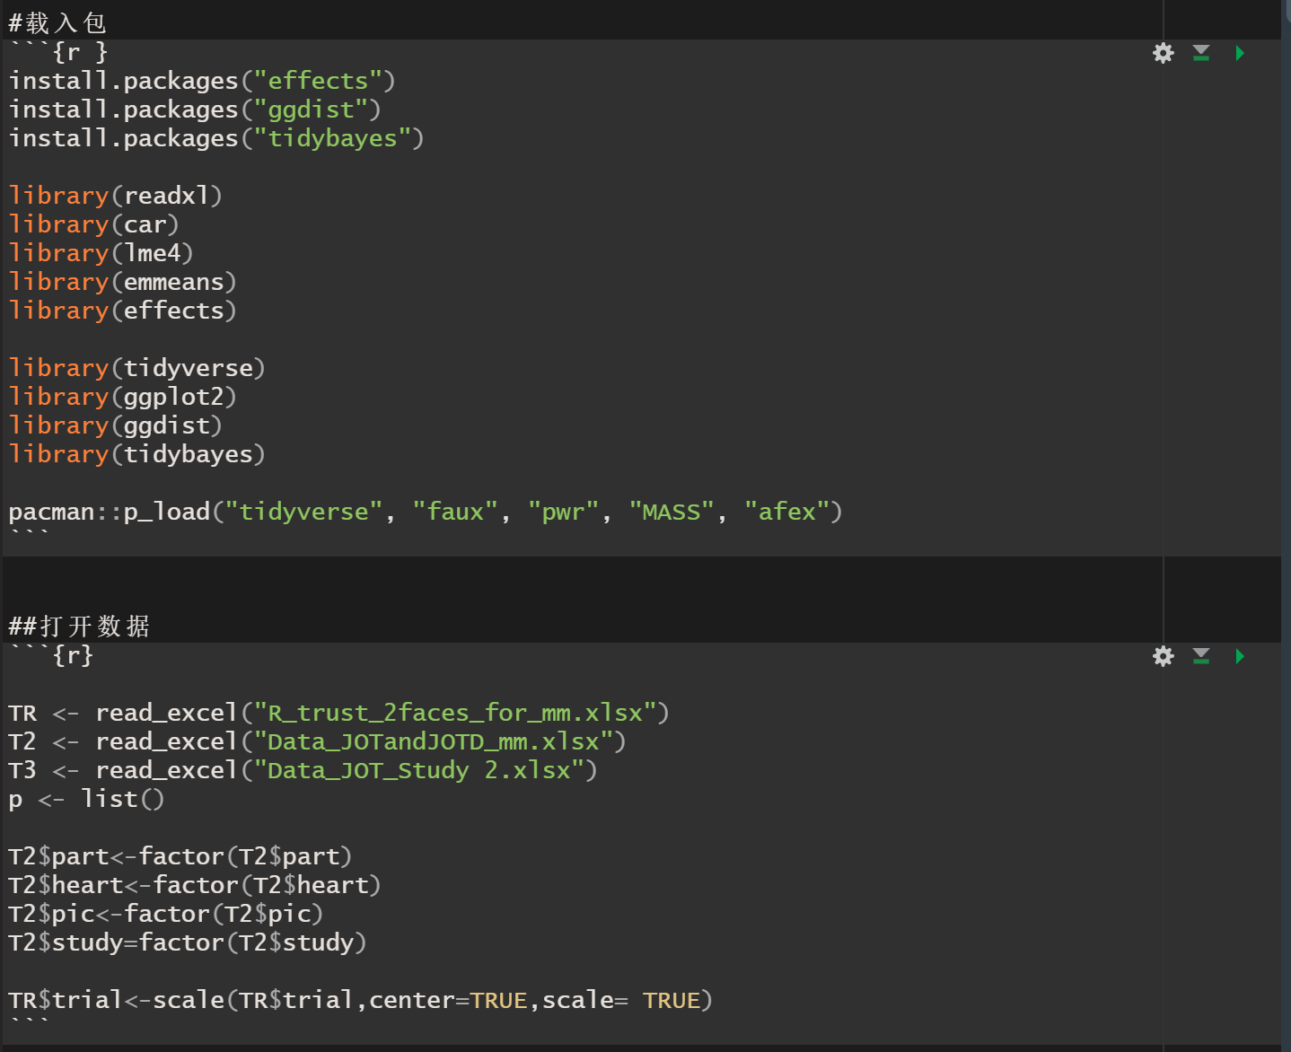
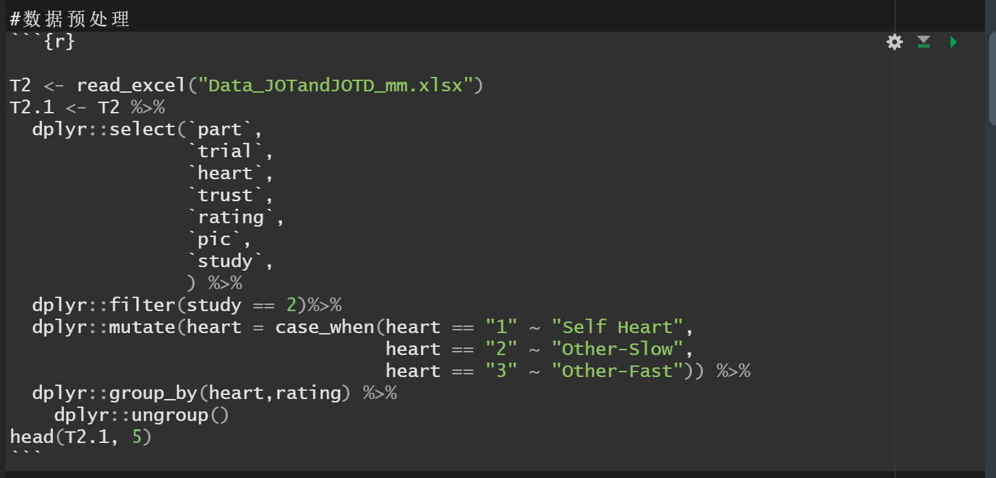
2.2
Study 2 Data analysis replication

Slide 13
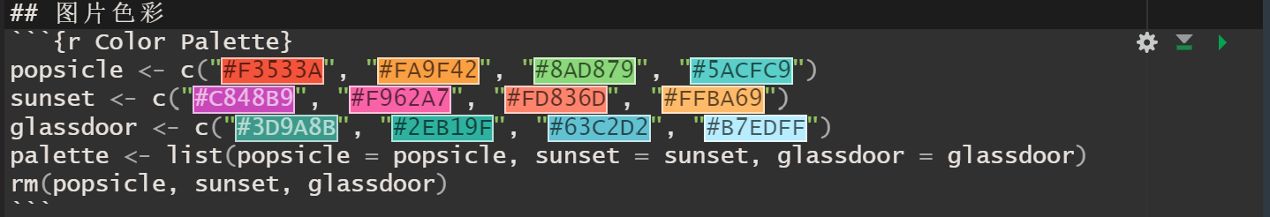
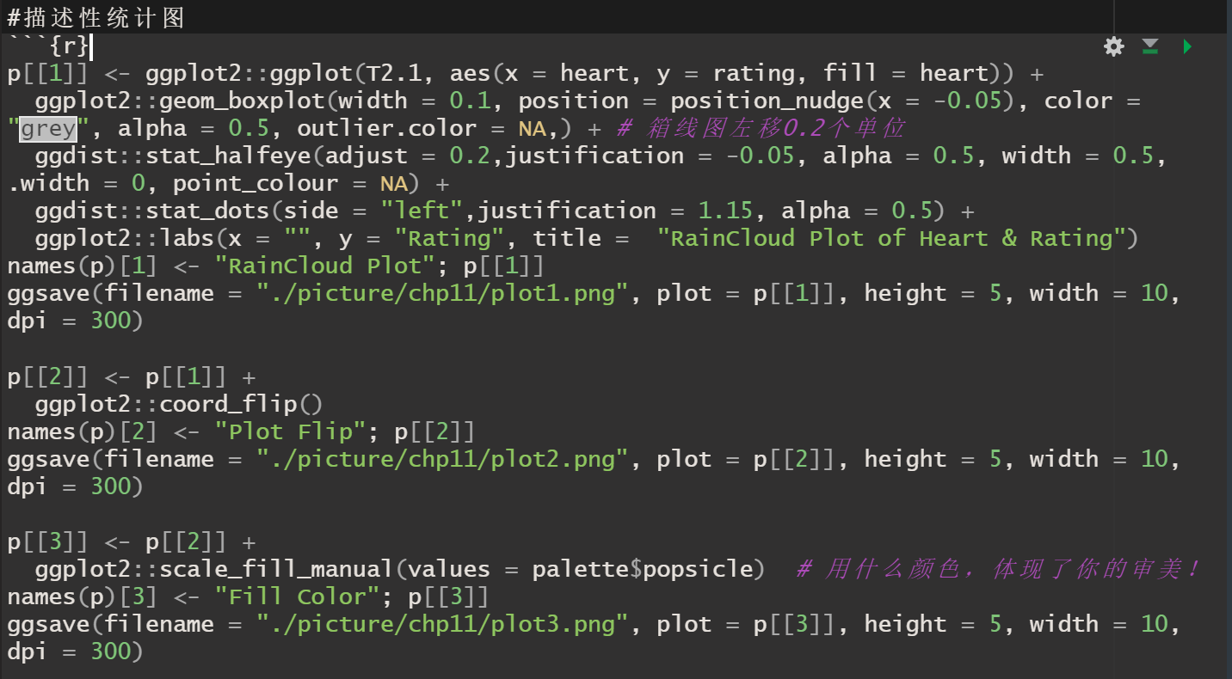
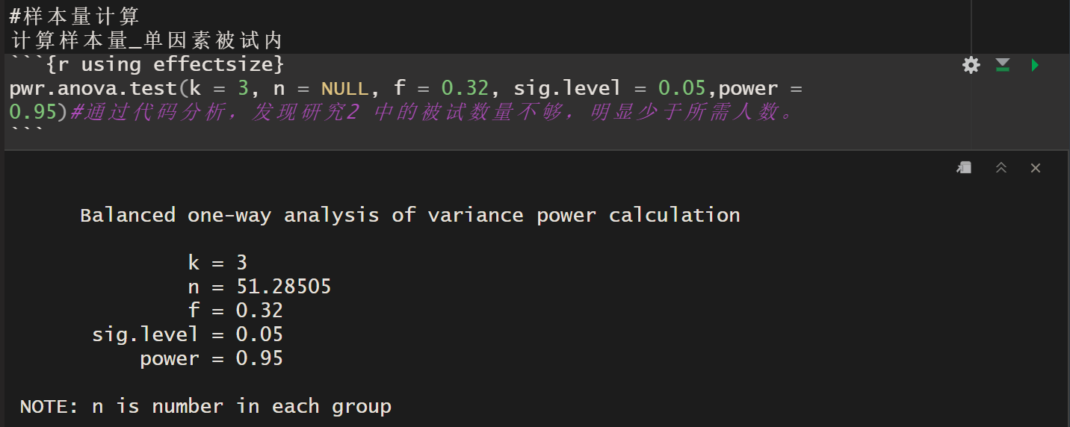
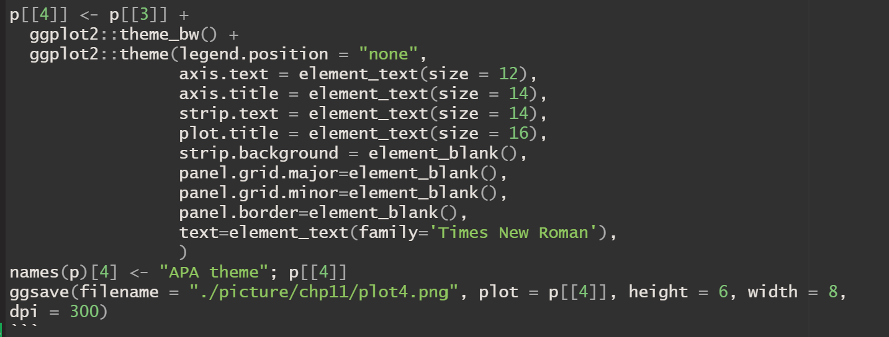
2.2
Study 2 Data analysis replication

Slide 14
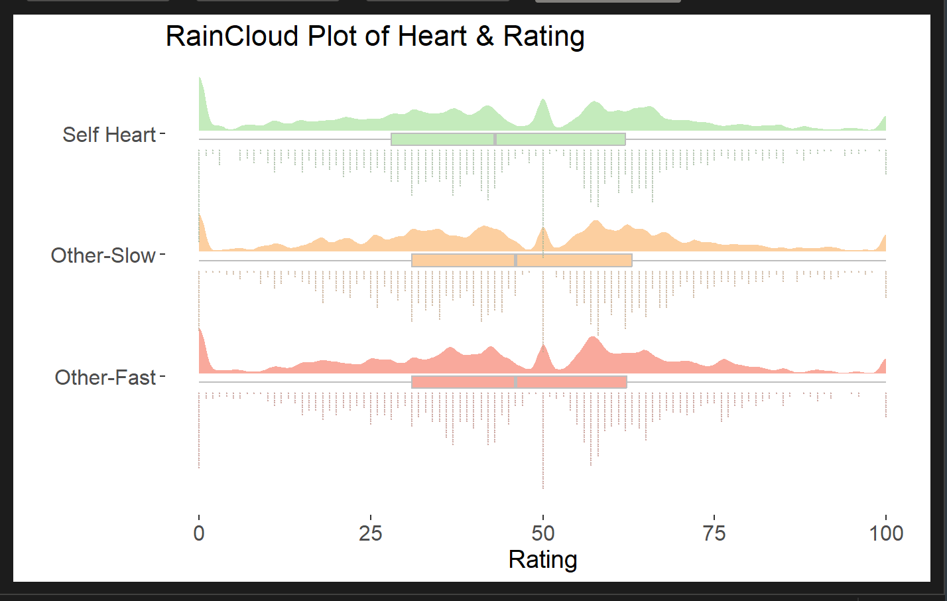
2.2
Study 2 Data analysis replication

Slide 15
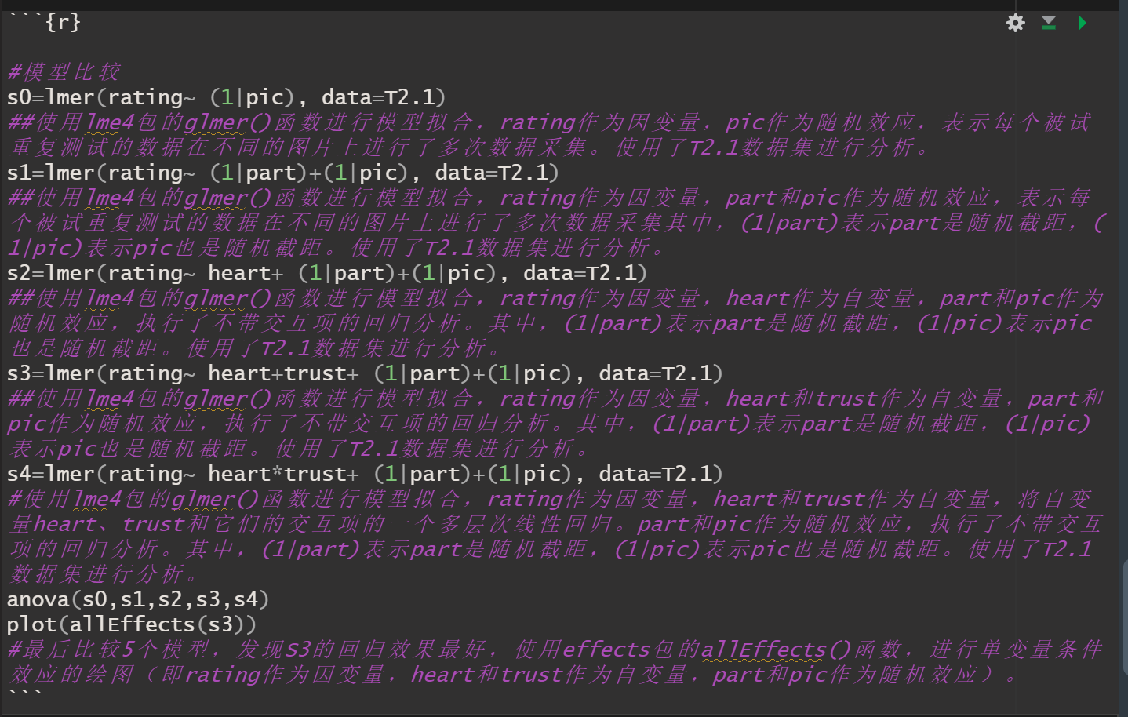
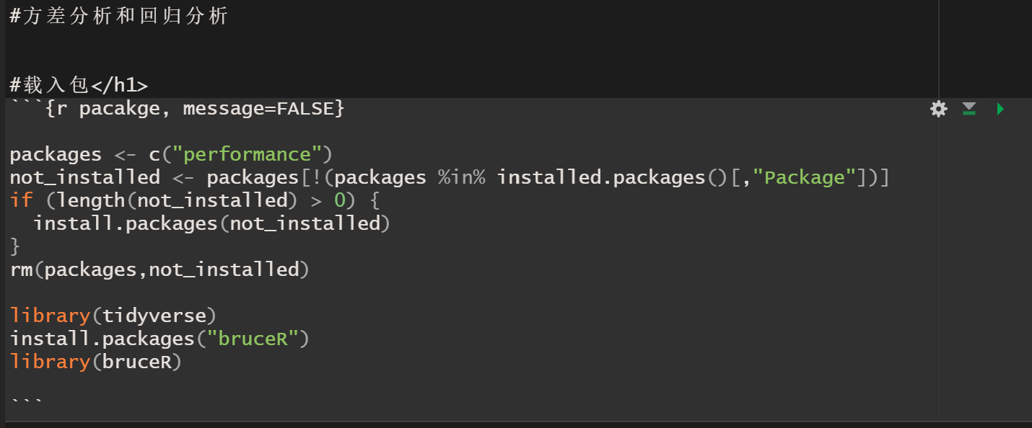
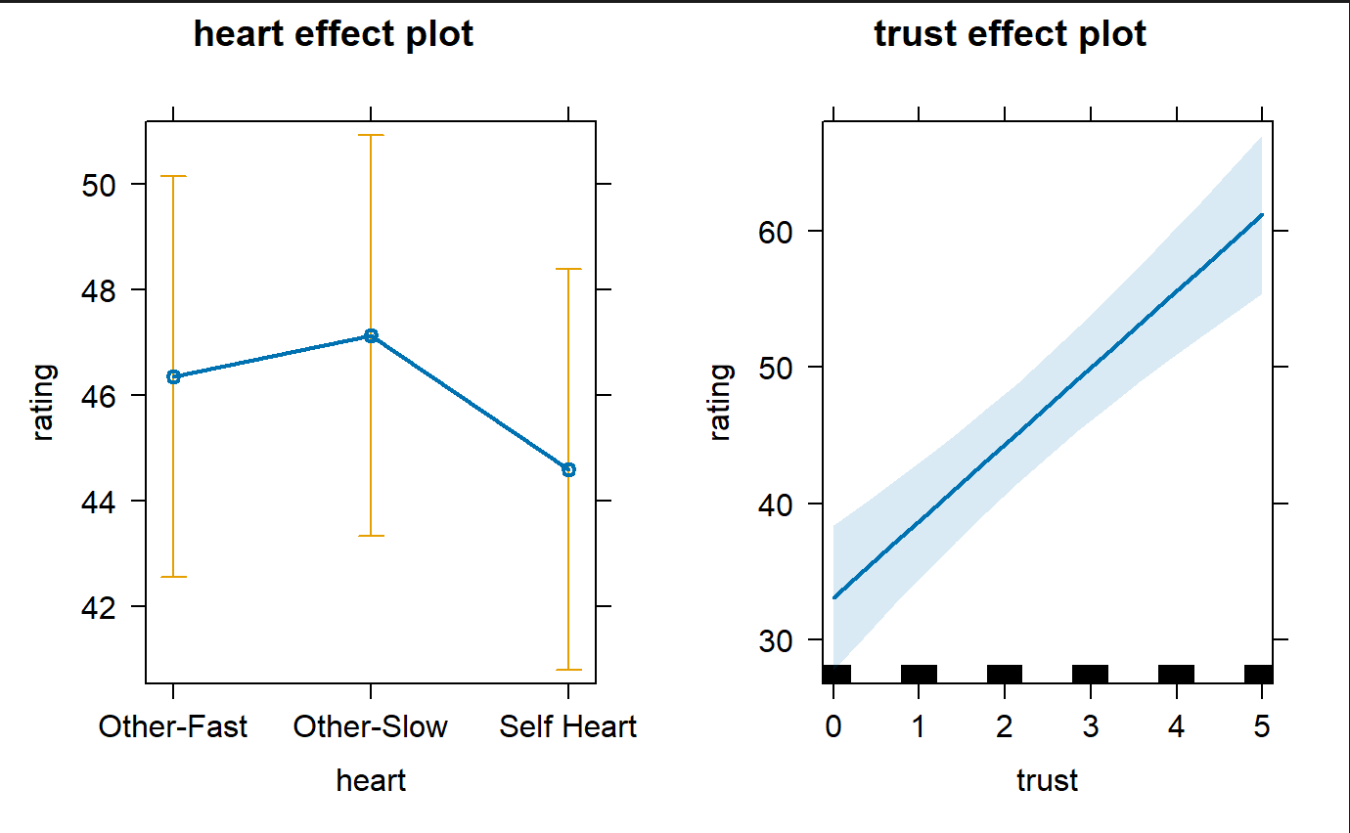
2.2
Study 2 Data analysis replication

Slide 16
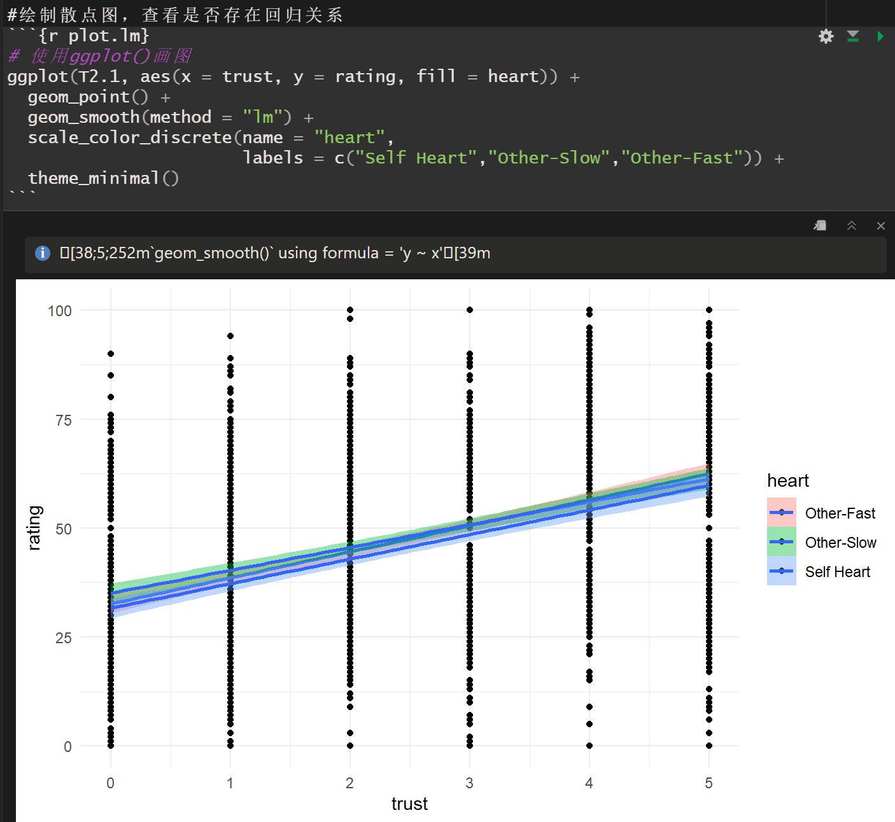
2.2
Study 2 Data analysis replication

Slide 17
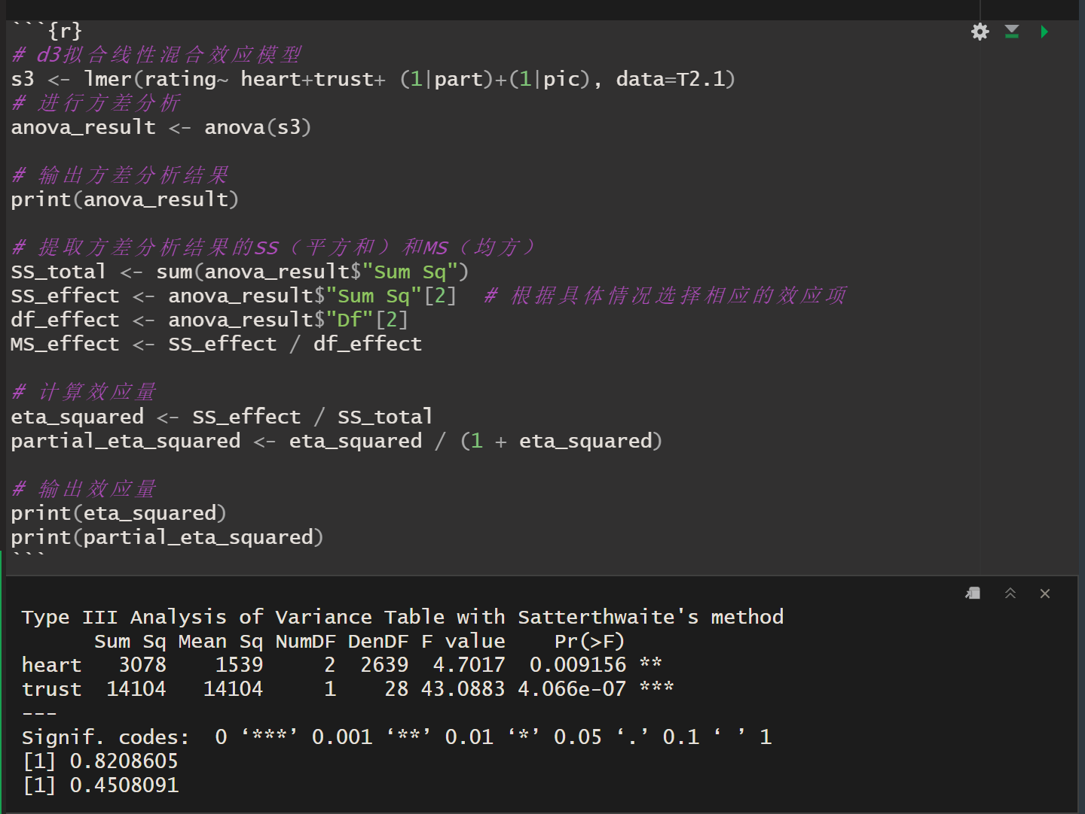
2.2
Study 2 Data analysis replication

Slide 18
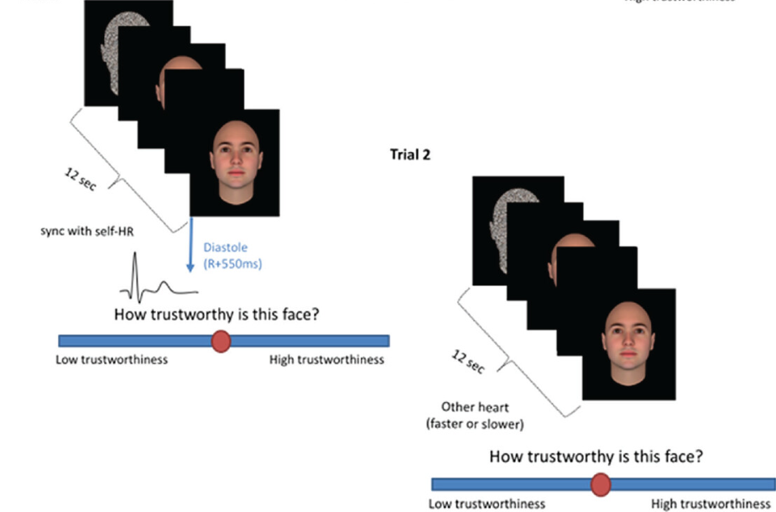
2.3
Study 3 Method
Participants： 29 volunteers
(age: M = 25.03 years, SD = 5.27; 20 females)
Design: Within-subjects design with rating as the independent variable(Other-fast, Other-slow, Diastole-Self)
Materials & Task：The stimuli, task, and procedures were identical to Study 2, stimuli in the synchronous condition were presented during cardiac diastole (R + 500 ms; diastole-self condition)

Slide 19
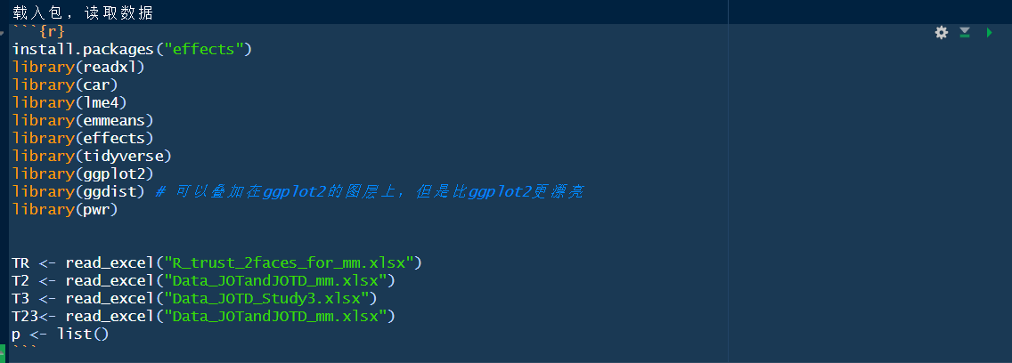
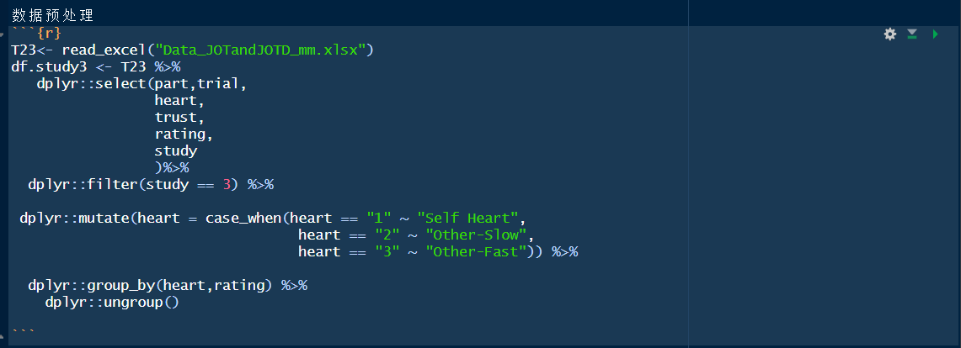
2.3
Study 3 Code Replication

Slide 20
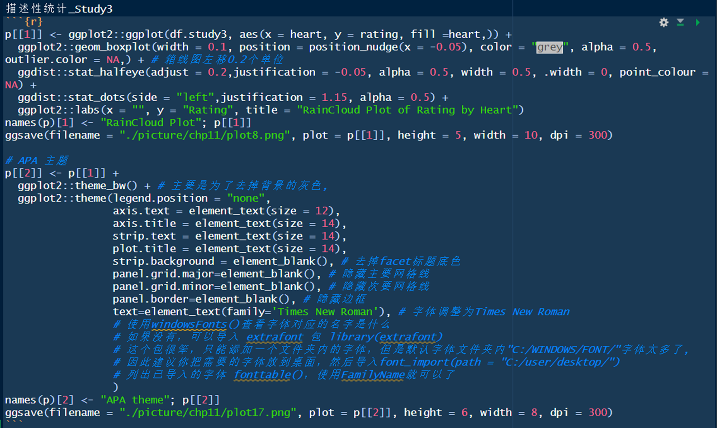
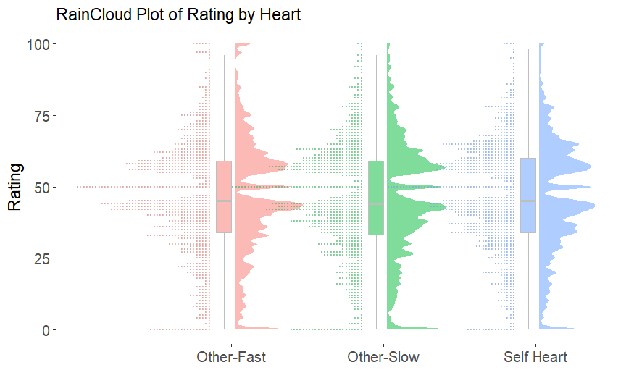
2.3
Study 3 Code Replication

Slide 21
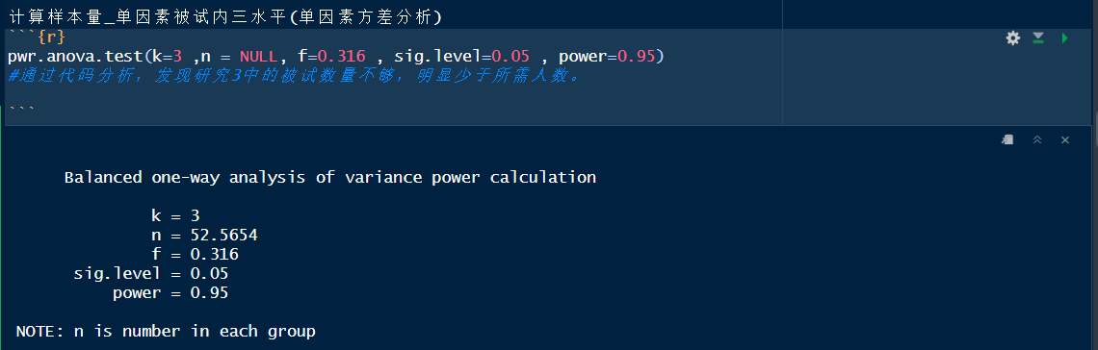
2.3
Study 3 Code Replication

Slide 22
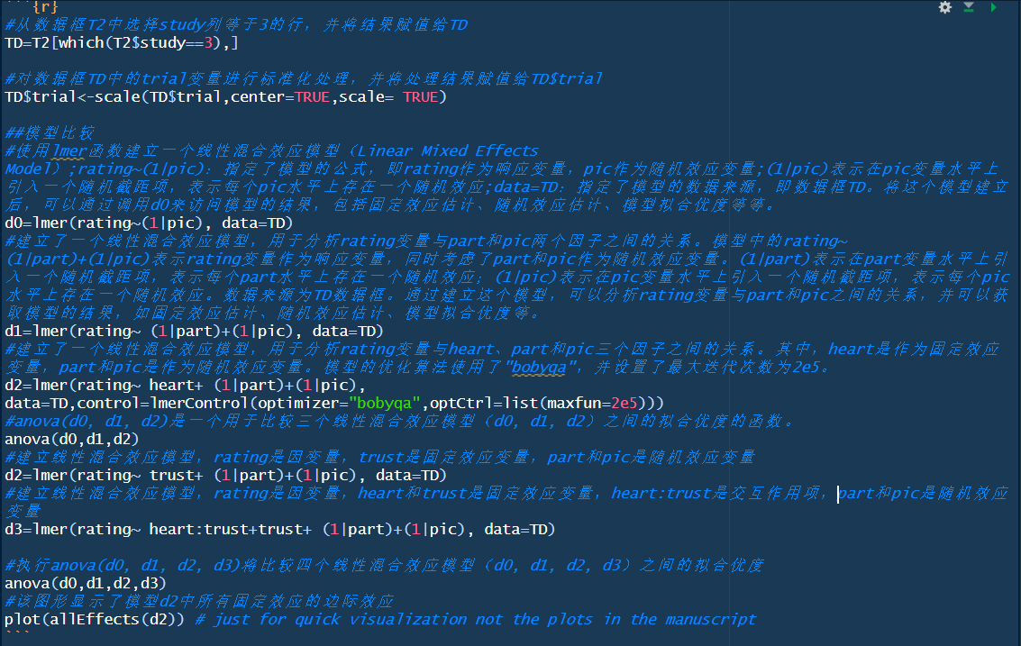
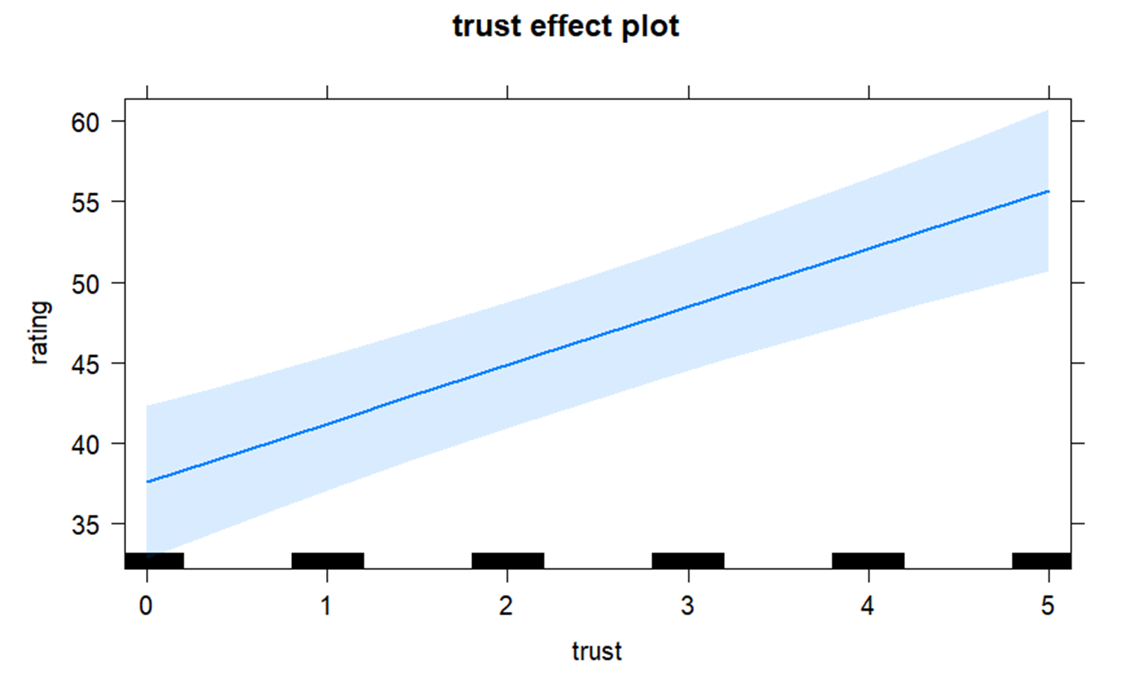
2.3
Study 3 Code Replication

Slide 23
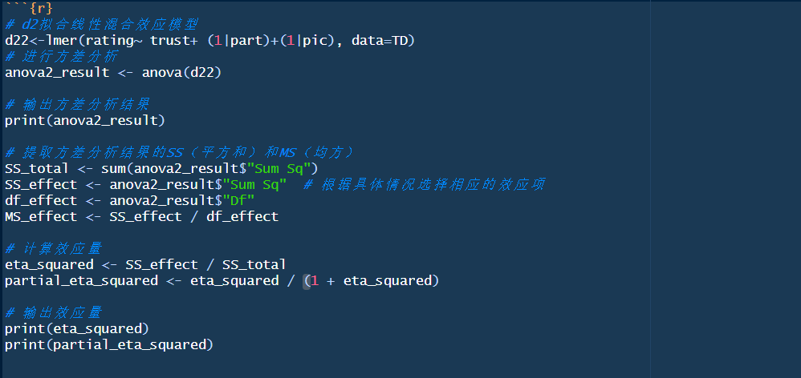
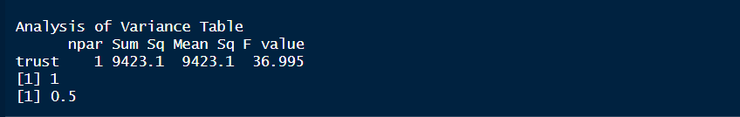
2.3
Study 3 Code Replication
Anova:

Slide 24
2.3
Study 3 Results
linear mixed model regression analysis :
Neither Rhythm (χ2 (2) = 2.48, p=0.29) nor Study (χ2 (1) = 0.002, p=0.96) were found to be significant.
No significant effect of rhythm, F(2, 54) = 0.93, p = .40, η_{p}² = .033
No significant interaction between rhythm and “objective” trustworthiness levels on subjective ratings.

Slide 25
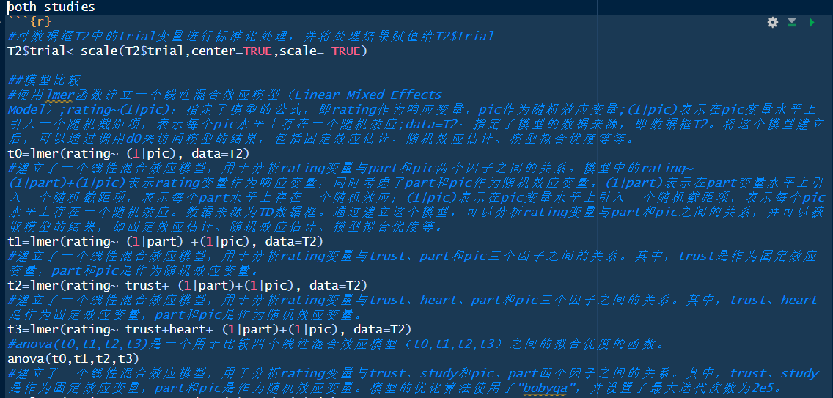
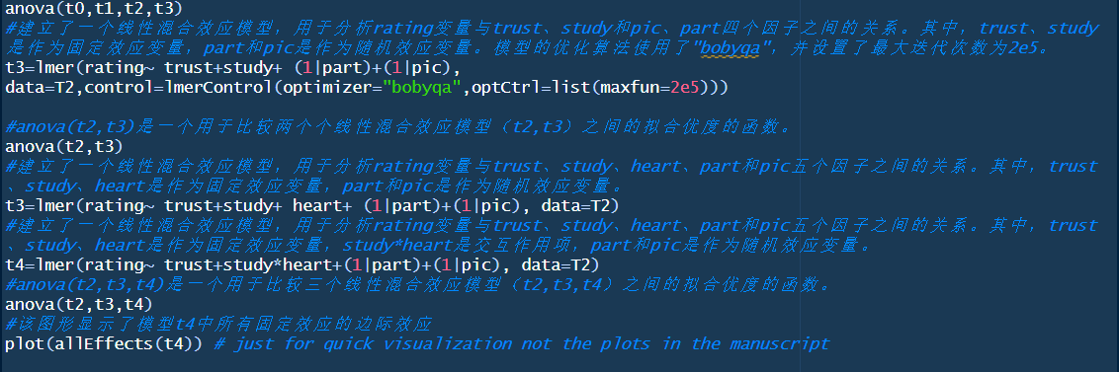
2.4
Study 2&3 Code Replication

Slide 26
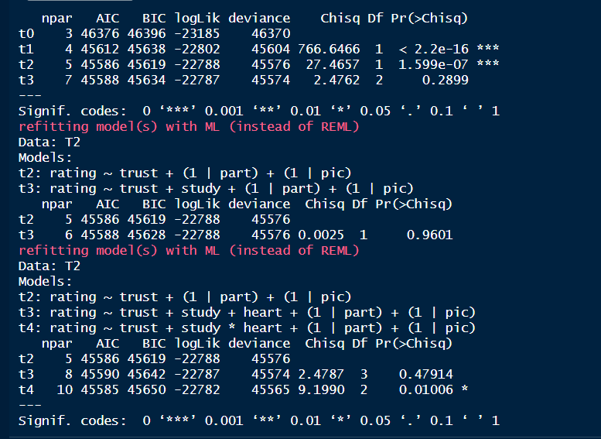
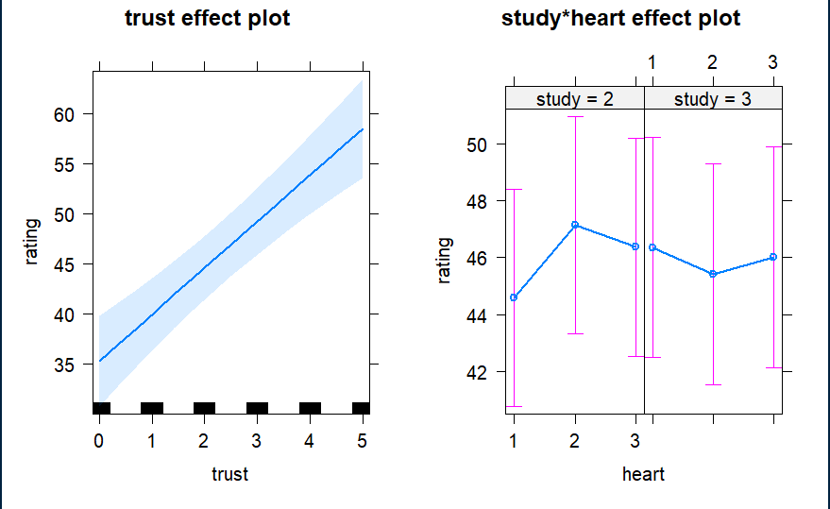
2.4
Study 2&3 Code Replication

Slide 27
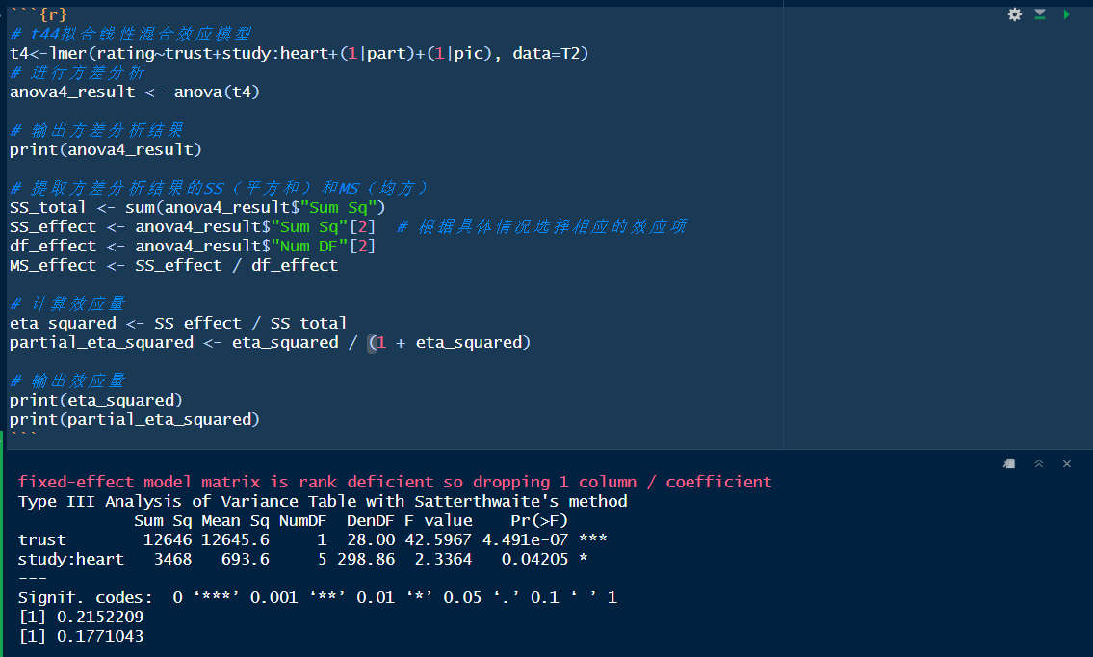
2.4
Study 2&3 Code Replication
Anova:

Slide 28
2.4
Study 2&3 Results
linear mixed model regression analysis :
Significant Rhythm × Study interaction, F(2, 110) = 7.32, p = .001, η_{p}² = .117, BF₁₀ = 7.74;
Neither the main effect of rhythm, F(2, 110) = 1.86, p = .16, η_{p}² = .033, BF₁₀ = 0.27, nor the main effect of study, F(1, 55) = 2.10, p = .15, η_{p}² = .037, BF₁₀ = 0.81, were significant.
No significant interaction between rhythm and “objective” trustworthiness levels on subjective ratings.
No correlation between interoceptive accuracy (M = 50.80, SD = 8.4) and the difference in trustworthiness ratings in the diastole-self and the average of the other-hearts conditions (r = −.25, p = .20).
Notes:
研究×有显著的节奏相互作用，但F（2， 110） = 7.32， p = .001， ηp2= .117， BF10= 7.74；节奏的主效应不显著，F（2， 110） = 1.86， p = .16， ηp2= .033， BF10= 0.27，研究的主要效应不显著，F（1， 55） = 2.10， p = .15， ηp2= .037， BF10= 0.81。至关重要的是，尽管显著的节律×研究相互作用仅表明研究3中的节律效应相对于研究2较小，但我们的BF分析表明，数据支持研究3的节律没有影响的零假设。与之前的研究一样，发现内感受准确性（M = 50.80，SD = 8.4）与舒张自我可信度评级的差异和其他心脏条件的平均值（r = −.25，p = .20）之间没有相关性。因此，与研究1和2相反，研究3没有显示参与者判断的调节作为呈现节律的函数，这表明发生同步的心动周期阶段（即收缩期）对于效果的发生至关重要。

Slide 29
3
Discussion

Slide 30
3
Discussion
The role of cardio-visual stimulation on trustworthiness judgments.
Faces presented in synchrony with the participant’s heart rhythm (at systole) were chosen less often as more trustworthy (Study 1) and were explicitly judged as less trustworthy (Study 2) than those presented asynchronously. These patterns suggest an influence of ongoing interoceptive information when people make social inferences from others’ faces.
presenting faces synchronized with the participant’s heart rhythm at diastole (Study 3) does not have an effect on participants’ judgments, indicating that the cardiac cycle phase is critical
a crucial role for the transient phasic cardiac afferent signals conveyed to the brain during systole in the modulation of social judgments.
Notes:
研究了有氧视觉刺激对可信度判断的作用。与受试者心律同步呈现的面孔（收缩时）被选择为更可信的面孔次数较少（研究1），并且被明确判断为比异步呈现的面孔更不可信（研究2）。这些模式表明，当人们从他人的脸上做出社会推断时，持续的内感受信息的影响。重要的是，我们发现了大量证据（BF10= 0.21;戴恩斯，2014年;杰弗里斯，1939/1961）表明呈现与受试者舒张时心律同步的面孔（研究3）对受试者的判断没有影响，表明心动周期阶段至关重要。
这些结果表明，收缩期间传达给大脑的瞬相心脏传入信号在社会判断的调节中起着至关重要的作用。

Slide 31
3
Discussion
Heightened arousal has been associated with reduced perceived trustworthiness of other people.
At systole, one’s own cardiac physiological information is accentuated, when faces are presented when one is in a state of heightened physiological arousal, they are more likely to be perceived as less trustworthy.
People tend to judge faces presented during systole (vs. diastole) as less trustworthy in conditions of high attentional load (Li et al., 2020).
“Diastolic states” are associated with increased trust or “systolic states” are associated with decreased trust. These effects are indeed driven by phasic activity taking place during systole alone.
Notes:
唤醒程度的提高与他人的可信度降低有关.
在高注意力负荷的情况下，人们倾向于判断收缩期（与舒张期相比）期间出现的面部不太可信（Li等人，2020）.
“舒张状态”是否与信任增加有关，或者“收缩状态”是否与信任降低有关。在我们的研究2和3之间观察到的解离消除了这种模式的歧义：这些影响确实是由收缩期间发生的阶段性活动驱动的。

Slide 32
3
Discussion
The specific cardio-visual effects observed on perceived trustworthiness reported here go beyond the multisensory integration process.
The observed selective cardio-visual effect on trustworthiness judgments at systole is likely to go beyond simple interoceptive-exteroceptive integration and may reflect a neuromodulation of saliency and orienting systems driven by the cardiac cycle.
Amygdala, an area known to mediate cardiac cycle modulations of threat processing (Garfinkel et al., 2014; Gray et al., 2009).
Notes:
对感知可信度观察到的特定心脏视觉影响超出了多感官整合过程。
观察到的选择性心脏视觉对收缩期可信度判断的影响可能超越简单的内感受-外感受整合，并可能反映由心动周期驱动的显著性和定向系统神经调控。
杏仁核是已知介导威胁处理的心动周期调节的区域（Garfinkel等人，2014;Gray等人，2009），对效价的反应比对面部唤醒的反应更大（Todorov等人，2008）。

Slide 33
3
Limitations and future directions
The role of cardio-visual stimulation on the processing of other types of social inferences from faces remains unknown.
Interoceptive accuracy did not seem to relate to the observed effects. Future studies should examine whether other interoceptive dimensions, such as interoceptive sensibility or awareness (Garfinkel et al., 2015), play a role on perceived trustworthiness or whether they interact with the phase of cardio-visual synchrony.
Cannot fully discard the possibility that other bodily changes covarying with the cardiac cycle (e.g., muscle spindle activity due to cardioballistic fluctuations; Birznieks et al., 2012),
Notes:
1.我们的研究考察了心脏视觉刺激对可信度判断的作用，但它对处理其他类型的面部社会推断的影响仍然未知。
2.在本研究中，内感受准确性似乎与观察到的效果无关。未来的研究应检查其他内感受维度，如内感受敏感性或意识（Garfinkel等人，2015），是否在感知可信度方面发挥作用，或者它们是否与心脏视觉同步阶段相互作用。
3.不能完全放弃其他身体变化与心动周期共存的可能性（例如，由于心道波动引起的肌肉纺锤体活动;Birznieks et al.， 2012），有助于调节认知和社会感知。

Slide 34
4
Conclusion

Slide 35
4
Conclusion
People less often chose faces presented in synchrony with their own cardiac systole as more trustworthy than faces presented out of synchrony. People also explicitly judged faces presented in synchrony with their cardiac systole as less trustworthy. The presentation of faces in synchrony with participants’ cardiac diastole did not modulate participants’ perceptions of the faces’ trustworthiness, suggesting that the systolic phase is necessary for such interoceptive effects.
These findings highlight the role of phasic interoceptive information in the processing of social information and provide a mechanistic account of the role of visceroception for social perception.
Notes:
参与者较少选择与自己的心脏收缩同步呈现的面孔比不同步呈现的面孔更值得信赖。
参与者还明确判断与心脏收缩同步的面部不太可信。
与受试者心脏舒张同步的面部呈现并没有调节受试者对面部可信度的看法，
这表明收缩期对于这种内感受效应是必要的。这些发现强调了阶段内感受信息在社会信息处理中的作用，并为内脏感受对社会感知的作用提供了机制说明。

Slide 36
5
The reasons for this study are selected
The data processing method used in this study is relatively basic, and has reference significance for our future data processing.
This study analyzes the trustworthiness of human face from the perspective of interperception, which opens a new idea for our future research..
Notes:
参与者较少选择与自己的心脏收缩同步呈现的面孔比不同步呈现的面孔更值得信赖。
参与者还明确判断与心脏收缩同步的面部不太可信。
与受试者心脏舒张同步的面部呈现并没有调节受试者对面部可信度的看法，
这表明收缩期对于这种内感受效应是必要的。这些发现强调了阶段内感受信息在社会信息处理中的作用，并为内脏感受对社会感知的作用提供了机制说明。

Slide 37
THANK YOU！
THANKS VERY MUCH FOR GUIDING
Group 12：姚梦晗 郗悦 沈桐
汇报时间 ：2023.6.19

